Slide 1

React command

Slide 2

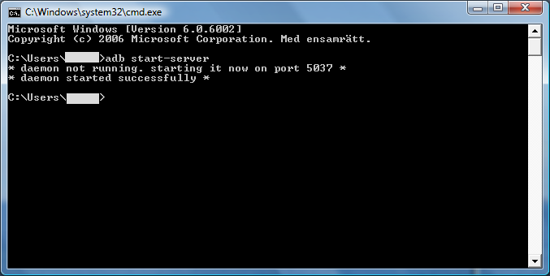
instalation step 1
go to directory where you want to create react project and open cmd
to open cmd in path search cut all and only type cmd
This Photo by Unknown author is licensed under CC BY-SA-NC.

Slide 3
instalation step 2
npx create-react-app test
cd test
code .

Slide 4
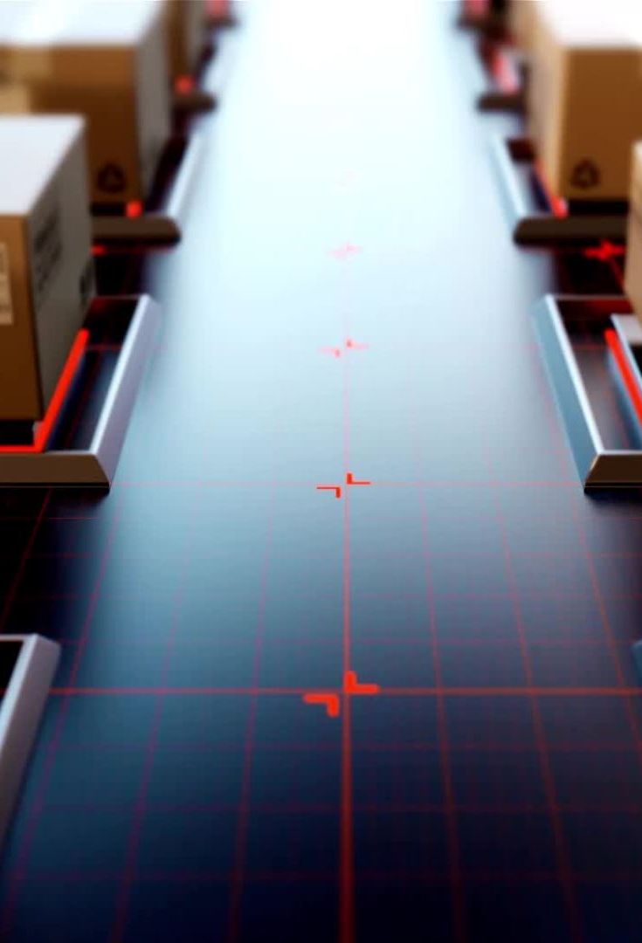
instalation step 3
open terminal and type following command
npm start
open browser and type http://localhost:3000 your project show

Slide 5

instalation step 4
you want to push your react project code on GitHub then
1. go to your github account and create new repository
2. copy that repository path
3. close your react app terminal use ( ctrl + c )
4. initialize your github repository

Slide 6

Github
git init
after that you add all folders for that use command
git add .
to commit changes on github repository you need to following command s
git commit -m "first-code-change"
git push paste your copy repository path

Slide 7

To clone from github you have to use following command
git clone https://github.com/Kushal-Kamble/react-project.git

Slide 8
cd = change directory
cd .. => one step directory path back
cd ../.. => two step directory path back
cd folder name => u go to that folder directory
cmd => command line interface
node src/B.js

